Slide 1
Introduction to PHP
Origins and Uses of PHP
Overview of PHP
General Syntactic Characteristics
Primitives, Operations and Expressions
Output
Control Statements
Arrays
Functions
Pattern Matching
Form Handling
Cookies
Session Tracking

Slide 2
The term PHP is an acronym for PHP: Hypertext Preprocessor. - PHP was originally an abbreviation of Personal Home Page. - PHP is a server-side scripting language that is embedded in HTML, designed specifically for web development. - PHP is a programming language that allows web developers to create dynamic content that interacts with databases. - PHP can be used to create websites, applications, customer relationship management systems and more. - It is open-source which means it is free to download and use. It is very simple to learn and use.
INTRODUCTION TO PHP

Slide 3
Characteristics of PHP
Simple and fast
Efficient
Secured
Flexible
Cross-platform, it works with major operating systems like Windows, Linux, and macOS.
Open Source
Powerful Library Support
Database Connectivity
Disadvantages of PHP
Not suitable for large Web Applications- Php code is hard to
maintain since it is not very modular.
Modification Problem – PHP does not allow the change in the
core behavior of the web applications.

Slide 4

PHP was developed by Rasmus Lerdorf, in 1994.
When a browser requests a document that includes PHP script, the Web server that provides the document calls its PHP processor.
The server determines that a document includes PHP script by the file- name extension.
If it is .php, .php3, or .phtml, the document has embedded PHP.
ORGINS AND
USES OF PHP

Slide 5
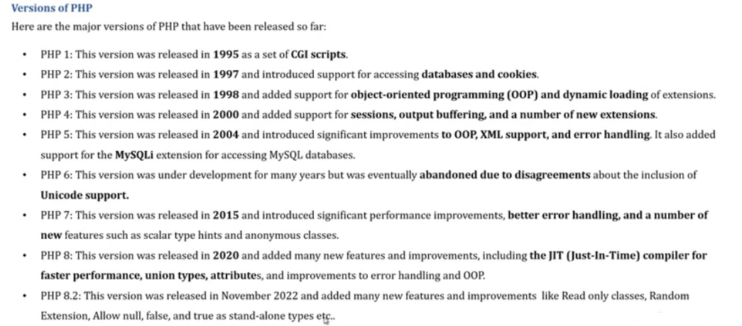

Slide 6
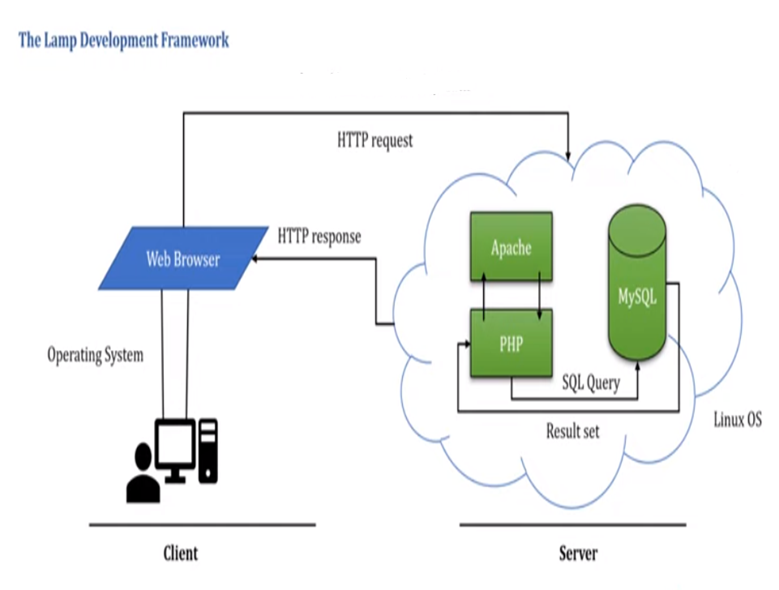
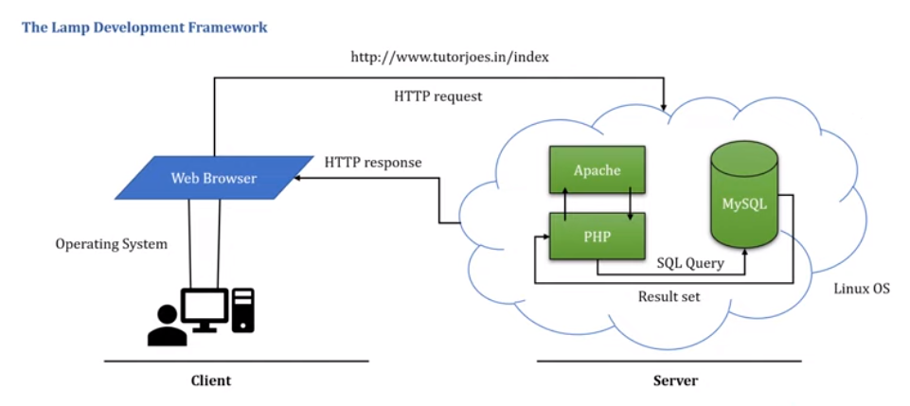

Slide 7
-Download PHP – XAMPP for Windows 8.2.0 Example
<html>
<body>
<?php
echo "My first PHP script!";
?>
</body>
</html>

Slide 8
The PHP processor has two modes of operation: copy mode and interpret mode.
It takes a PHP document file as input and produces an HTML or XHTML document file.
When the PHP processor finds markup code (which may include embedded client-side script) in the input file, it simply copies it to the output file.
When the processor encounters PHP script in the input file, it interprets it and sends any output of the script to the output file.
This implies that the output from a PHP script must be HTML or XHTML, either of which could include embedded client-side script.

Slide 9
The new file (the output file) is sent to the requesting browser.
The client never sees the PHP script.
If the user clicks View Source while the browser is displaying the document, only the markup (and embedded client-side script) will be shown, because that is all that ever arrives at the client.
Separated in files with the tag.
Php commands can make up an entire file, or can be contained in html.
Program lines end in ";" or you get an error.
PHP scripts are executed on the server.
PHP supports many databases (MySQL, Informix, Oracle, Sybase, Solid, PostgreSQL, Generic ODBC, etc.,).

Slide 10
GENERAL SYNTACTIC CHARACTERISTICS
PHP scripts either are embedded in HTML or XHTML documents or are in files that are referenced by such documents.
PHP code is embedded in documents by enclosing it between the tags.
If a PHP script is stored in a different file, it can be brought into a document with the include construct, which takes the filename as its parameter— for example, include(“hello.php”);
The included file can contain markup or client-side script, as well as PHP code, but any PHP script it includes must be the content of a <?php tag.
PHP allows comments to be specified in three different ways. Single-line comments can be specified either with # or with //, as in JavaScript. Multiple- line comments are delimited with /* and */, as in many other programming languages.

Slide 11
The reserved words of PHP
and | else | global | require | virtual
break | elseif | if | return | xor
case | extends | include | static | while
class | false | list | switch
continue | for | new | this
default | foreach | not | true
do | function | or | var

Slide 12
PRIMITIVES, OPERATIONS AND EXPRESSIONS
PHP has four scalar types—Boolean, integer, double, and string;
Two compound types—array and object;
and two special types— resource and NULL.

Slide 13
- All variable names in PHP begin with a dollar sign($). - The part of the name after the dollar sign is like the names of variables in many common programming languages: a letter or an underscore followed by any number (including zero) of letters, digits, or underscores. - PHP variable names are case sensitive. - PHP is compatible with almost all servers used today (Apache, IIS, etc.,) . - PHP is easy to learn and runs efficiently on the server side.
Variable
<p>
<?php
?myvar =“Hello World”; echo $myvar;
?>
<p>
Assigned by value - $foo = "Bob"; $bar = $foo;
Assigned by reference, this links vars $bar = &$foo;

Slide 14
PHP has a single integer type, named integer(corresponds to the long type of C). In most cases, this is 32 bits, or a bit less (not fewer) than 10 decimal digits.
Integer Type
Double Type
PHP's double type corresponds to the double type of C and its successors. Double literals can include a decimal point, an exponent, or both. The exponent has an E or an e, followed by a possibly signed integer literal. There need not be any digits before or after the decimal point, so both .345 and 345. are legal double literals.
String Type
Characters in PHP are single bytes. There is no character type. A
single character data value is represented as a string of length 1.

Slide 15
String literals are defined with either single (') or double quotes (") delimiters. In single-quoted string literals, escape sequences, such as \n, are not recognized and the values of embedded variables are not substituted. This substitution is called interpolation.
Print ‘The sum is :$sum’ is exactly as it is typed.ie The sum is:$sum
In double-quoted string literals, escape sequences are recognized, and embedded variables are replaced by their current values.
$sum=10;
Print “The sum: $sum”; o/p:
The sum: 10
Boolean Type
The only two possible values for the Boolean type are TRUE and

Slide 16
FALSE, both of which are case insensitive. If an integer expression is used in Boolean context, it evaluates to FALSE if it is zero; otherwise, it is TRUE. If a string expression is used in Boolean context, it evaluates to FALSE if it is either the empty string or the string "0"; otherwise, it is TRUE.
PHP Object
An object is a data type that not only allows storing data but also information on, how to process that data. An object is a specific instance of a class which serve as templates for objects. Objects are created based on this template via the new keyword. Every object has properties and methods corresponding to those of its parent class.
NULL
The special NULL value is used to represent empty variables in PHP.

Slide 17
A variable of type NULL is a variable without any data. NULL is the only possible value of type null.
Resource
A resource is a special variable, holding a reference to an external resource. Resource variables typically hold special handlers to opened files and database connections.
Arithmetic Operators and Expression
PHP has the usual (for C-based programming languages) collection of arithmetic operators (+, -, *, /, %, ++, and --). If either operand is a double, the operation is double and a double result is produced.
Arithmetic Operator

Slide 18
Operator | Description | Example | Result
+ | Addition | X=2 X+2 | 4
- | Subtraction | X=2 5-x | 3
* | Multiplication | X=4 X*5 | 20
/ | Division | 15/5 5/2 | 3 2.5
% | Modulus | 5%2 10%8 | 1 2
++ | Increment | X=5 X++ | X=6
-- | Decrement | X=5 X-- | X=4

Slide 19
Function | Parameter Type | Returns
floor | Double | Largest integer less than or equal to the parameter
Ceil | Double | Smallest integer greater than or equal to the parameter
Round | Double | Nearest integer
Srand | Integer | Initialize a random number generator with the parameter
Rand | Two Integer | A pseudo random number greater than the first parameter and smaller than the second
Abs | Number | Absolute value of the parameter
Min | One or more numbers | Smallest
max | One or more numbers | Largest

Slide 20
The only string operator is the concatenation operator (.), used to put two string values together. To concatenate two string variables together, use the concatenation operator.
String Operations
<?php
$txt1=“Hello!”;
$txt2=“Have a nice day!”;
Echo $txt1 . “ “ . $txt2;
?>
O/P:
Hello! Have a nice day!

Slide 21
Function | Parameter Type | Returns
Strlen | A string | The number of characters in the string.
Strcmp | Two string | Zero of the two string are identical, a negative number the first string belongs before the second.
Strpos | Two string | The character position in the first string of the first character of the second string.
Substr | A string and an integer | The substring of the string parameter.
Chop | A string | The parameter with all whitespace character removed from its end.
trim | A string | The parameter with all whitespace character removed from both ends.
ltrim | A string | The parameter with all whitespace characters removed from its beginning.
Strtolower | A string | Lowercase converted into uppercase.
strtoupper | A string | Uppercase converted into lowercase.

Slide 22
Scalar Type Conversion
PHP includes both implicit and explicit type conversions. Implicit type conversions are called coercions. The context can cause a coercion of the type of the value of the expression. Whenever a numeric value appears in string context, the numeric value is coerced to a string. whenever a string value appears in numeric context, the string value is coerced to a numeric value. If the string contains a period, an e, or an E, it is converted to double; otherwise, it is converted to an integer. When a double is converted to an integer, the fractional part is dropped; rounding is not done.
Explicit type conversions can be specified in three ways.
Using the syntax of C, an expression can be cast to a different type. The cast is a type name in parentheses preceding the expression. For example, if the value of $sum is 4.777, the following produces 4: (int)$sum

Slide 23
Another way to specify explicit type conversion is to use one of the functions intval, doubleval, or strval. For example, if $sum is still 4.77 7, the following call returns 4:
intval($sum)
The third way to specify an explicit type conversion is the settype function, which takes two parameters: a variable and a string that specifies a type name. For example, if $sum is still 4 . 777, the following statement converts the value of $sum to 4 and its type to integer:
settype($sum, "integer");

Slide 24
The print function is used to create simple unformatted output. It
can be called with or without parentheses around its parameter.
OUTPUT
Example
print "Apples are red <br/> kumquats aren’t <br/> Print (47); produce 47
Print “The result is: $result <br/>”;
The general form of a call to printf is as follows:
Printf (literal_string, param 1,param 2,…)
The literal string can include labeling information about the
parameters whose values are to be displayed.

Slide 25
It also contains format codes for those values. The form of the format codes is a percent sign (%) followed by a field width and a type specifier. The most common type specifiers are s for strings, d for integers, and f for floats and doubles.
Consider the following examples:
% 10 s—a character string field of 10 characters
%6d—an integer field of 6 digits %5.
2f—a float or double field of 8 spaces, with two digits to the right of the decimal point, the decimal point, and 5 digits to the left.
$day = “Tuesday”;
$high = 79;
Printf(“The high on %7s was %3d”, $day, $high);

Slide 26
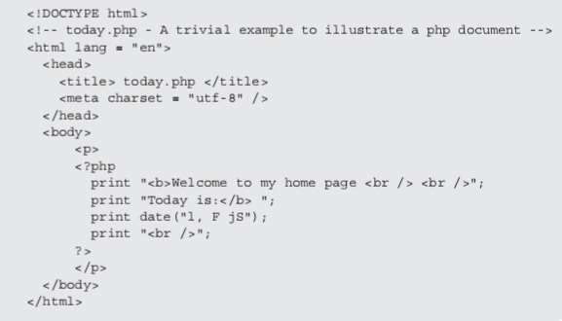

Slide 27
Welcome is my page
Today is Saturday. June 1st
CONTROL STATEMENT
The control statements of PHP are not remarkable—they are similar to those of C and its descendants. The control expression used in PHP’s control statements can be of any type. The interpreter evaluates the control expression and, in the cases of selection and loop statements, coerces the resulting value, if necessary, to Boolean.
Relational Operators
PHP uses the eight relational operators of JavaScript. The usual six (>, =, <=, ! =, and ==) have the usual meanings. It also has ===, which produces TRUE only if both operands are the same type and have the same value, and ! ==, the opposite of ===.

Slide 28
There are six Boolean operators: and, or, xor, !, &&, and | |. The and and && operators perform the same operation, as do or and ||.
Boolean Operators
Selection Statements
If
PHP’s if statement is like that of C. The control expression can be an expression of any type, but its value coerced to Boolean.
The controlled statement segment can be either a single statement or a compound statement. An is can include any number of elseif clauses.

Slide 29
If ($day == “Saturday” || $day == “Sunday”) ($today = “weekend”);
else
($today = “weekday”;)
Switch
switch(n) {
case label1:
code to be executed if n=label1; break;
case label2:
code to be executed if n=label2;
break; case label3:
code to be executed if n=label3; break;
. . .

Slide 30
Default:
code to be executed if n is different from all labels;
}
Loop Statements
The while, for, and do-while statements of PHP are exactly like those of JavaScript. PHP also has a foreach statement. The following example computes the factorial of $n:
$fact = 1;
$count = 1;
while ($count < $n) {
$count++;
$fact *= $count;
}

Slide 31
$count = 1;
$sum = 0; do {
Example
$sum += $count;
$count++;
} while ($count <= 100);
The following example computes the factorial of $n:
for ($count = 1, $fact = 1; $count < $n;) {
$count++;
$fact *= $count;
}

Slide 32
Break and Continue
The break statement can be used to terminate the execution of a for, foreach, while, or do-while construct.
The continue statement is used in loop constructs to skip the remainder of the current iteration but continue execution at the beginning of the next.
An Example
The next example is meant to illustrate the form of an HTML-PHP document, as well as some simple mathematical functions and the intermingling of HTML and PHP in a document.
The sqrt function returns the square root of its parameter; the pow function raises its first parameter to the power of its second parameter.

Slide 33
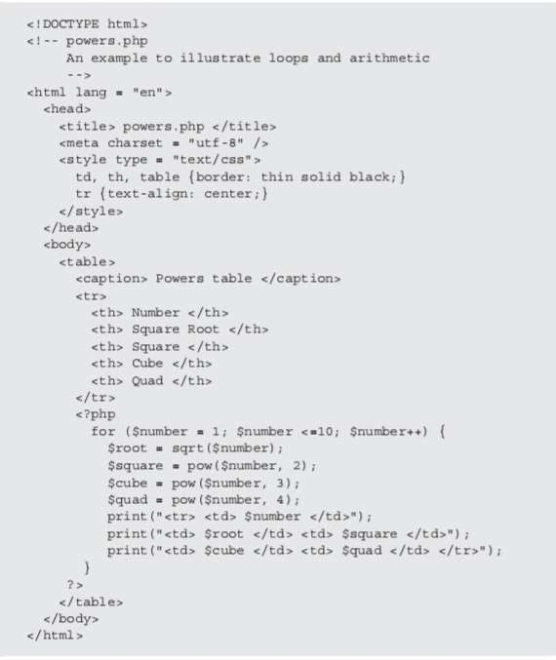

Slide 34
Display the output of powers.php

Slide 35
Arrays
Arrays in PHP are unlike those of any other common programming language. They are best described as a combination of the arrays of a typical language and associative arrays or hashes, found in some other languages, such as Ruby and Python.
This feature makes PHP arrays highly flexible built-in data structures.
Each array element consists of two parts: a key and a value.
Arrays in PHP is a type of data structure that allows us to store multiple elements of similar data type under a single variable thereby saving us the effort of creating a different variable for every data.

Slide 36
Array Creation:
In PHP, the array() function is used to create an array.
There are three types of arrays:
Indexed arrays - Arrays with a numeric index
Associative arrays - Arrays with named keys
Multidimensional arrays - Arrays containing one or more arrays
Example:
<?php
$cars = array("Volvo", "BMW", "Toyota"); echo count($cars);
?>

Slide 37
$list = array(17, 24, 45, 91);
$list = array(1 => 17, 2 => 24, 3 => 42, 4 => 91);
$list = array();
$ages = array("Joe" => 42, "Anu" => 29, "Bif" =>17); Accessing array elements:
Individual array elements can be accessed by subscripting, as in other programming languages. The value in the subscript, which is enclosed in brackets, is the key of the value being referenced. The same brackets are used regardless of whether the key is a number or a string.
For example, the value of the element whose key is "Anu" in the $ages array can be set to 29 with the following statement:
$ages['Anu'] = 29;

Slide 38
The list construct can be used to assign multiple elements of an array to scalar variables in one statement.
For example, in the statements,
$trees = array("oak", "pine", "binary");
list($hardwood, $softwood, $data_structure) = $trees;
$hardwood, $softwood, and $data_structure are set to "oak", "pine", and "binary", respectively.
Functions for dealing with arrays:
A whole array can be deleted with unset, as with a scalar variable. Individual elements of an array also can be removed with unset, as in the following code:
$list = array(2, 4, 6, 8);
unset($list[2]);
After executing these statements, $list has three remaining elements with keys 0, 1, and 3 and elements 2, 4, and 8.

Slide 39
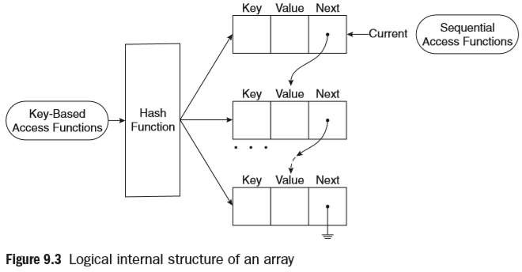

Slide 40
Sequential Access to Array Elements:
PHP includes several different ways to access array elements in sequential order. Every array has an internal pointer that references one element of the array. We call this the current pointer.
This pointer is initialized to reference the first element of the array at the time the array is created. The element being referenced by the pointer can be obtained with the current function.
$cities = array("Hoboken", "Chicago", "Moab", "Atlantis");
$city = current($cities);
print("The first city is $city <br />");
When interpreted, the following output is produced:
• The first city is Hoboken

Slide 41
Sorting Arrays:
The sort function, which takes an array as a parameter, sorts the values in the array, replacing the keys with the numeric keys, 0, 1, 2, . . . . The array can have both string and numeric values.
The string values migrate to the beginning of the array in alphabetical order. The numeric values follow in ascending order.
The asort function is used to sort arrays that correspond to hashes. It sorts the elements of a given array by their values, but keeps the original key-value associations.
The ksort function sorts its given array by keys, rather than values. The key-value associations are maintained by the process.
The rsort, arsort, and krsort functions behave like the sort, asort, and ksort functions, respectively, except that they sort into the reverse orders of their counterparts.

Slide 42
<!DOCTYPE html>
<!-- sorting.php - An example to illustrate several of the sorting functions -->
<html lang = "en">
<head>
<title> Sorting </title>
<meta charset = "utf-8" />
</head>
<body>
<?php
$original = array("Fred" => 31, "Al" => 27,
"Gandalf" => "wizard",
"Betty" => 42, "Frodo" => "hobbit");
?>
<h4> Original Array </h4>
<?php
foreach ($original as $key => $value) print("[$key] => $value <br />");
$new = $original; sort($new);
?>
<h4> Array sorted with sort </h4>
<?php
foreach ($new as $key => $value) print("[$key] = $value <br />");
$new = $original; asort($new);
?>
<h4> Array sorted with asort </h4>
<?php
foreach ($new as $key => $value) print("[$key] = $value <br />");
$new = $original; ksort($new);
?>
<h4> Array sorted with ksort </h4>
<?php
foreach ($new as $key => $value) print("[$key] = $value <br />");
?>
</body>
</html>

Slide 43
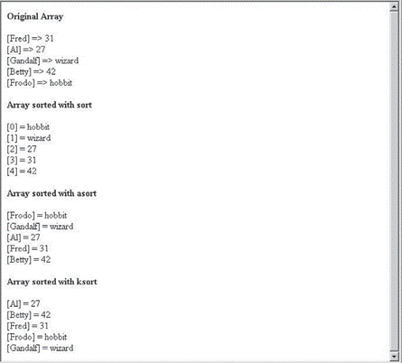

Slide 44
Functions
PHP supports user-defined functions that are typical of C-based
programming languages.
The general form of a PHP function definition is as follows:
function name ([parameters]) {
… }
The square brackets around the parameters mean that the parameters are optional.
Remember that function names are not case sensitive.
So, a document cannot have a function named sum and another
named Sum.
The PHP interpreter will see them as the same function and issue an error message stating that the document has two definitions for the same function.
The return statement is used in a function to specify the value to be returned to the caller.

Slide 45
Parameters:
As with JavaScript, we call the parameters in the call to a function actual parameters. We call the parameters that are listed in the function definition formal parameters. An actual parameter can be any expression. A formal parameter must be a variable name.
function max_abs($first, $second) {
$first = abs($first);
$second = abs($second);
if ($first >= $second)
return $first;
else
return $second; }
This function returns the larger of the absolute values of the two given numbers.
It potentially changes both of its formal parameters, the actual parameters in the caller are unchanged (passed by value).

Slide 46
Pass-by-reference
Parameters that provide two-way communication between the caller and the function are needed—for example, so a function can return more than one value.
One common way to provide two-way communication is to pass the address of the actual parameter, rather than its value, to the function. Then, when the formal parameter is changed (in the function), it also changes the corresponding actual parameter. Such parameters are said to be passed by reference.
Pass-by-reference parameters can be specified in PHP in two ways.
One way is to add an ampersand (&) to the beginning of the name of the formal parameter that you want to be passed by reference. Of course, passing by reference makes sense only if the actual parameter is a variable.

Slide 47
Pass-by-reference
The other way to specify pass-by-reference is to add an ampersand to the actual parameter in the function call. These two techniques have identical semantics.
Consider the following example:
function set_max(&$;max, $first, $second)
{ If ($first >= $second)
$max = $first; else
$max = $second;
}
In this example, the first actual parameter in the caller is set to the larger of the second and third parameters.

Slide 48
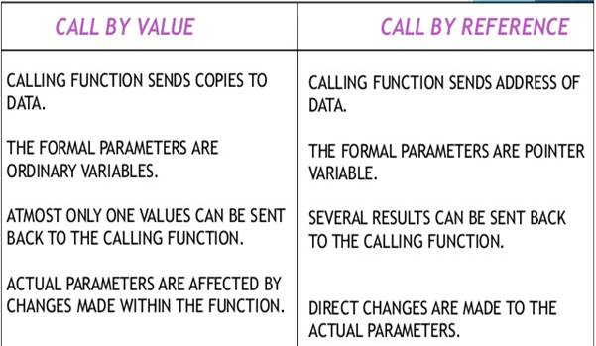

Slide 49
The Scope of Variables :
The default scope of a variable defined in a function is local. If a variable defined in a function has the same name as a variable used outside the function, the nonlocal variable is hidden. A local variable is visible only in the function in which it is used.
For example, consider the following code:
function summer($list) {
$sum = 0;
foreach ($list as $value)
$sum += $value;
return $sum;
}
$sum = 10;
$nums = array(2, 4, 6, 8);
$ans = summer($nums);
print "The sum of the values in \$nums is: $ans <br />";
print "The value of \$sum is still: $sum <br />";

Slide 50
The Lifetime of Variables :
In PHP, a local variable in a function can be specified to be static by declaring it with the reserved word static. Such a declaration can include an initial value, which is only assigned the first time the declaration is reached.
For example, consider the following function definition:
function do_it ($param) {
static $count = 0;
count++;
print "do_it has now been called $count times <br />";
... }
When called, this function displays the number of times it has been called, even if it is called from several different places.
The fact that its local variable $count is static allows this to be done.

Slide 51
Pattern Matching
PHP includes two different kinds of string pattern matching using regular expressions: one that is based on POSIX regular expressions and one that is based on Perl regular expressions, like those of JavaScript.
The POSIX regular expressions are compiled into PHP, but the Perl-Compatible Regular Expression (PCRE) library must be compiled before Perl regular expressions can be used.
The preg_match function takes Perl-style regular expression two parameters, the first of which is the as a string. The second parameter is the string to be searched.
The following code is illustrative:
if (preg_match("/^PHP/", $str))
print "\$str begins with PHP <br />";
else
print "\$str does not begin with PHP <br />";

Slide 52
Form Handling
One common way for a browser user to interact with a Web server is through forms.
Form data is placed in user-accessible variables implicitly by the PHP system, making form handling very simple.
The user submits the form to the server by clicking the form’s Submit button.
When PHP is used for form handling, the PHP script is embedded in an HTML document, as it is with other uses of PHP.
The form-handler is typically a file on the server with a script for processing input data.
The document that defines the form specifies the document that
handles the form data in the action attribute of its <form> tag.
For example, if a form has a text box named phone and the form method is POST, the value of that element is available in the PHP script as follows: $_POST["phone"].

Slide 53
Cookies
Introduction to cookies:
A cookie is a small object of information that includes a name and a textual value. A cookie is created by some software system on the server.
Every Hypertext Transfer Protocol (HTTP) communication between a browser and a server includes a header, which stores information about the message.
The header part of an HTTP communication can include cookies. So every request sent from a browser to a server, and every response from a server to a browser, can include one or more cookies.
Cookies allow servers to record browser activities.

Slide 54
PHP Support for cookies:
Cookies are created and set to values with the setcookie function. This function takes one or more parameters.
The first parameter, which is mandatory, is the cookie’s name given as a string.
The second, if present, is the new value for the cookie, also a string. If the value is absent, setcookie undefines the cookie.
The third parameter, when present, is the expiration time in seconds for the cookie, given as an integer.
The default value for the expiration time is zero, which specifies that the cookie is destroyed at the end of the current session.

Slide 55
For example, consider the following call to setcookie:
setcookie("voted", "true", time() + 86400);
This call creates a cookie named "voted" whose value is "true" and whose lifetime is one day (86,400 is the number of seconds in a day).
Session Tracking
In some cases, information about a session is needed only during the session. Also, the needed information about a client is nothing more than a unique identifier for the session—commonly used in shopping cart applications. For these cases, a different process, named session tracking, can be used.

Slide 56
In particular, session arrays often store a unique session ID for a session. One significant way that session arrays differ from cookies is that they can be stored on the server, whereas cookies are stored on the client.
In PHP, a session ID is an internal value that identifies the session. Session IDs need not be known or handled in any way by PHP scripts. PHP is made aware that a script is interested in session tracking by calling the session_ start function, which takes no parameters.
the function retrieves the $_SESSION array, which stores any session variables and their values that were registered.

Slide 57
Session key-value pairs are created or changed by assignments to the $_SESSION array. They can be destroyed with the unset operator. Consider the following example:
session_start();
if (!IsSet($_SESSION["page_number"]))
$_SESSION["page_number"] = 1;
$page_num = $_SESSION["page_number"];
print("You have now visited $page_num page(s) <br />");
$_SESSION["page_number"]++;
the script sets page_number to 1, produces the line,
You have now visited 1 page(s)
and increments page_number.

